Slide 1

Energy-Efficient Neuromorphic Computing
MS Project: End Term Presentation
Khritish Kumar Behera 17125
Mail: khritish17@iiserb.ac.in
Indian Institute of Science Education and Research [IISER] Bhopal
Advisor: Dr. Kuntal Roy
Mail: kuntal@iiserb.ac.in
Date: 23-11-2021

Slide 2
Content
Recap
Motivation
Artificial neural network
Character recognition model
Magnetic anisotropy
Simulation
Magnetic Field applied along in-plane easy and hard axis
Perpendicular anisotropy
Neural network using spintronics
Multiferroic composites
Magnetostriction
Proposed device
Experimental
Magnetic Thermal Annealing
Results after Magnetic Thermal Annealing
Experimental apparatus
LabView measurement automation
Future Plan

Slide 3
Content
Recap
Motivation
Artificial neural network
Character recognition model
Magnetic anisotropy
Simulation
Magnetic Field applied along in-plane easy and hard axis
Perpendicular anisotropy
Neural network using spintronics
Multiferroic composites
Magnetostriction
Proposed device
Experimental
Magnetic Thermal Annealing
Results after Magnetic Thermal Annealing
Experimental apparatus
LabView measurement automation
Future Plan

Slide 4
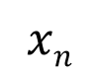
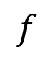
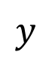
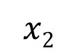
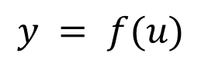
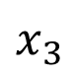
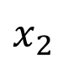
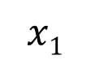
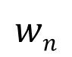

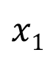
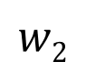
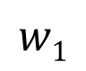
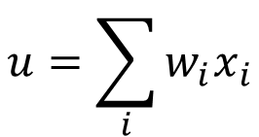
Energy-Efficient Neuromorphic Computing
Neuromorphic Computing is usually performed on traditional transistor based devices
$$u=\sum_{i}{w_{i}x_{i}}$$
$$x1$$
$$w1$$
$$y = f(u)$$
$$x2$$
$$w2$$
$$Σ$$
.
.
.
$$wn$$
Spintronic devices can be more energy-efficient than traditional transistors
$$f$$
$$xn$$
$$y$$
Piezoelectric
$$x1$$
Spintronic devices have inherent advantages over transistors
Weight, Sum and Threshold function
Non-volatile in nature
$$x_{2}$$
$$x_{3}$$
Neuron
Read
Insulator
Magnetostrictive
Write
Non-Boolean Computing

Slide 5

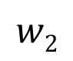
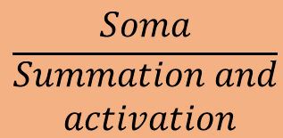
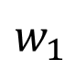
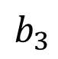
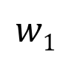
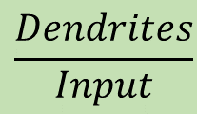
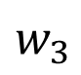
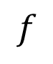
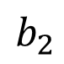
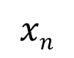
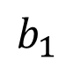
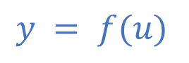
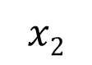
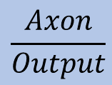
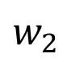
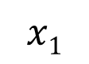
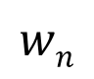
Artificial Neural Network (ANN)
$$w_{1}$$
$$b_{1}$$
$$\frac{Dendrites}{Input}$$
$$x1$$
$$w_{2}$$
$$w1$$
$$b_{2}$$
$$x2$$
.
.
.
$$w_{3}$$
$$\frac{Soma}{\begin{aligned}Summation and \\ activation\end{aligned}}$$
$$Σ$$
$$y = f(u)$$
$$w2$$
$$b_{3}$$
$$f$$
$$xn$$
$$wn$$
Input layer
Hidden layer
Output layer
$$\frac{Axon}{Output}$$
System of interconnected neurons
Architecture
Output of a neuron, connected to all other neurons in the next layer
Three layers: Input, Hidden and Output layer
Weights and biases are the optimizing parameter

Slide 6
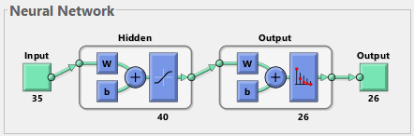
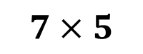
Artificial Neural Network: Neural Architecture
$$7×5$$
Input
35 (7x5)-bit word of the test character
Output
26-bit word suggesting the character
Input
A: 01110 10001 10001 11111
10001 10001 10001
Output
A: 10000000000000000000000000
B: 01000000000000000000000000

Slide 7
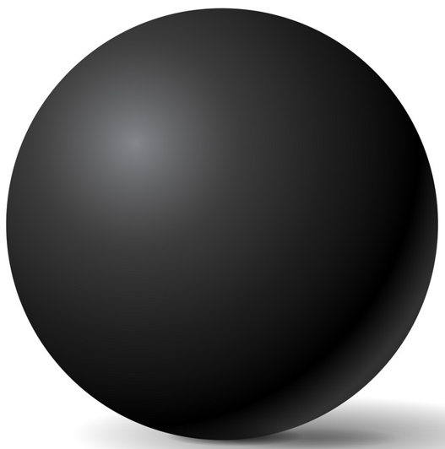
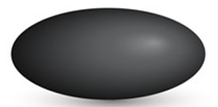


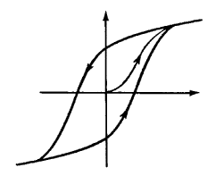
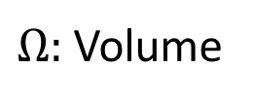
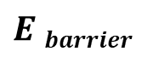
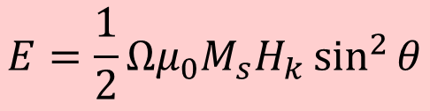
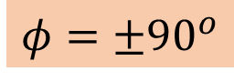
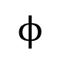
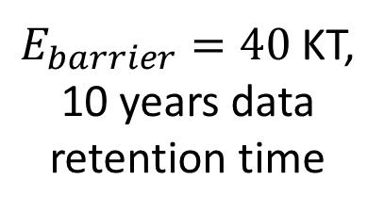
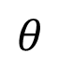
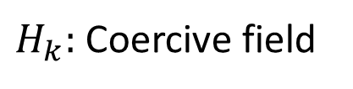
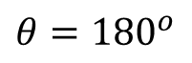
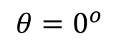
Magnetic Anisotropy
CoFeB
Sphere
Ellipsoid
Elliptical Cylinder
No anisotropy
Difficult to fabricate
In-plane
Shape anisotropy
x
Magnetization
30-80 KT at 300 K
$$E=\frac{1}{2}Ωμ_{0}M_{s}H_{k}\sin^{2}{θ}$$
$$ϕ$$
$$θ$$
$$E barrier$$
z
y
$$φ=±90^{o}$$
$H_{k}:$Coercive field
M
$Ω:$ Volume
$E_{barrier}=40$ KT,
10 years data retention time
H
$$θ={180}^{o}$$
$$θ=0^{o}$$
H_{k}

Slide 8
Content
Recap
Motivation
Artificial neural network
Character recognition model
Magnetic anisotropy
Simulation
Magnetic Field applied along in-plane easy and hard axis
Perpendicular anisotropy
Neural network using spintronics
Multiferroic composites
Magnetostriction
Proposed device
Experimental
Magnetic Thermal Annealing
Results after Magnetic Thermal Annealing
Experimental apparatus
LabView measurement automation
Future Plan

Slide 9
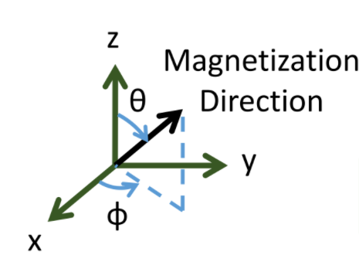
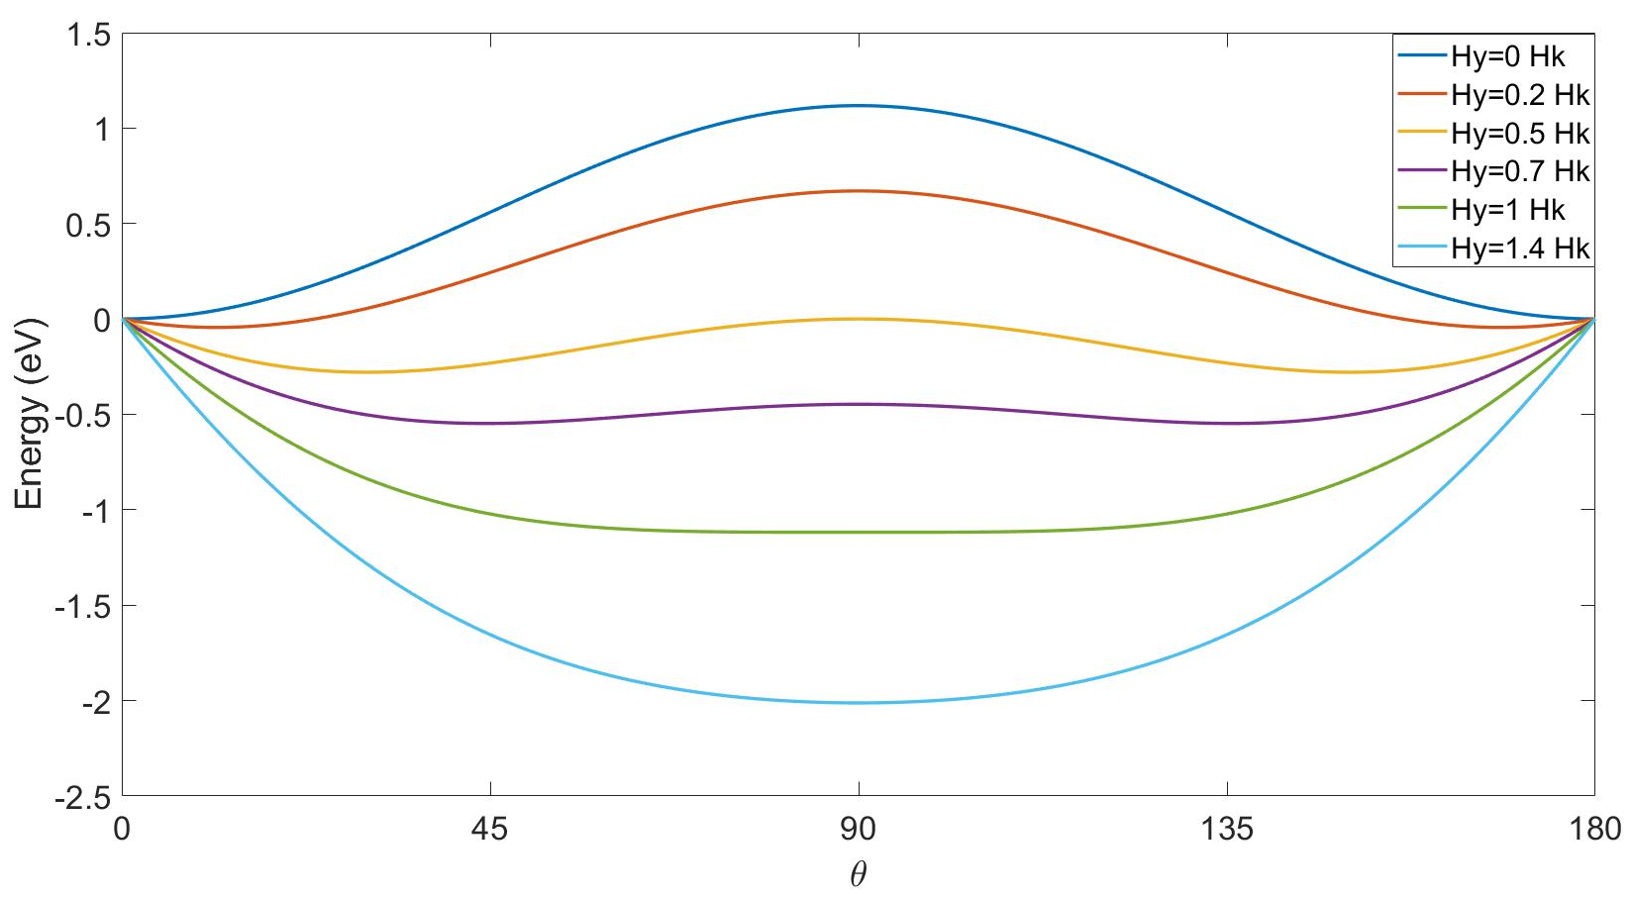
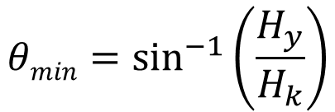
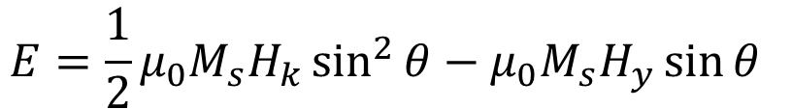
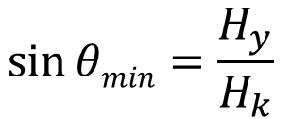

Magnetic Field applied along in-plane hard axis
x
z
z
y
x
y
$$E=\frac{1}{2}μ_{0}M_{s}H_{k}\sin^{2}{θ−μ_{0}M_{s}H_{y}\sin{θ }}$$
$$\frac{dE}{dθ}=0$$
$$\sin{θmin=\frac{H_{y}}{H_{k}} }$$
$$θmin=\sin^{−1}\left(\frac{H_{y}}{H_{k}}\right)$$
Magnetic Field, along +y axis

Slide 10



Magnetic Filed applied along in-plane easy axis
x
z
z
y
x
$$E=\frac{1}{2}μ_{0}M_{s}H_{k}\sin^{2}{θ−μ_{0}M_{s}H_{z}\cos{θ }}$$
y
$$θmin=\sin^{−1}\left(\frac{H_{z}}{H_{k}}\right)$$
Magnetic Field, along Z-axis

Slide 11















Perpendicular Anisotropy
CoCrPt
z
z
Magnetization
direction
Easy axis:
$$θ=0^{o},{180}^{o}$$
$$θ= 0^{o}$$
Bulk
$$θ$$
Hard axis:
$$θ={90}^{o}$$
y
MgO
y
$$φ$$
CoFeB
x
x
$$θ={180}^{o}$$
t_{CoFeB}<1.3 nm
$$E_{shape}\left(θ,φ\right)=\frac{1}{2}{ μ}_{0 }M_{s }^{2}Ω{ N}_{d}\left(θ,φ\right)$$
Interface
$$N_{d−xx}+N_{d_{−}yy}+N_{d−zz}=1$$
$$N_{d}\left(θ,φ\right)=N_{d−xx}\sin^{2}{θ}\cos^{2}{φ}+{N_{d−yy}\sin^{2}{θ}sin}^{2}{φ}+{N_{d−zz} cos}^{2}{θ}$$
$$E_{shape}\left(θ,φ\right)=\frac{1}{2}μ_{0}M_{s}[H_{k}+H_{d}\cos^{2}{φ]Ω\sin^{2}{θ}}$$
$$HPMA=H_{k}+H_{interface}$$
Circular cross-section
$$H_{d}=\left(N_{d_{−}xx}−N_{d_{−}yy}\right)M_{s}$$
$$=0$$
$$E_{PMA}\left(θ\right)=\frac{1}{2}{ μ}_{0 }M_{s}{ H}_{PMA} Ω\sin^{2}{θ}$$
$$H_{k}=\left(N_{d_{−}yy}−N_{d_{−}zz}\right)M_{s}$$
IISER Bhopal
Notes:
There are 2 kind of possibilities: Bulk anisotropy and Interface anisotropy
Where Nd(teta, phi) comes form -> spherical coordinate system
What is the requirement for perpendicular anisotropy

Slide 12







Perpendicular interface anisotropy
z
$$N_{d_{−}zz}≫N_{d_{−}yy}≃1$$
$$k_{i}=1.3 mJ/m^{2}$$
MgO
Bulk
Interfacial anisotropy
$$tCoFeB<1.3 nm$$
$$\frac{K}{Ω}=\frac{1}{2}{ μ}_{0}M_{s}^{2}\left(N_{d_{−}yy}−N_{d_{−}zz}\right)+\frac{k_{i}}{tCoFeB}$$
y
CoFeB
x
Interface
$$\frac{K}{Ω}tCoFeB=−\left(\frac{1}{2}{ μ}_{0}M_{s}^{2}\right)tCoFeB+k_{i}$$
Ikeda, S. et al. "A perpendicular-anisotropy CoFeB–MgO magnetic tunnel junction."
Nature Materials 9 (2010) 721-724

Slide 13
Content
Recap
Motivation
Artificial neural network
Character recognition model
Magnetic anisotropy
Simulation
Magnetic Field applied along in-plane easy and hard axis
Perpendicular anisotropy
Neural network using spintronics
Multiferroic composites
Magnetostriction
Proposed device
Experimental
Magnetic Thermal Annealing
Results after Magnetic Thermal Annealing
Experimental apparatus
LabView measurement automation
Future Plan

Slide 14




Multiferroic Composites
Multiferroic Composite
Magnetostrictive
Piezoelectric
E
Strain
P
$$\boxed{α_{ME}=μ_{0}\frac{∂M}{∂σ}\frac{∂σ}{∂E}}$$
Piezoelectricity
Magnetoelectricity (intrinsic)
$$ε$$
M
$$σ$$
H
Magnetostriction

Slide 15







Magnetostriction
Magnetostrictive Materials: Certain ferromagnetic specimen changes its shape (strain$ε$:$∂l/l$) during the process of magnetization
Magnetic Anisotropy
Stress Anisotropy
$$σ:Stress$$
$$Ω:Volume$$
$$\frac{3}{2}λ σ Ω \cos^{2}θ$$
$$σ=Yε=Yd\frac{V}{t}$$
Cobalt:
$$\frac{3}{2}λ=−30×{10}^{−6}$$
FeGa:
$$\frac{3}{2}λ=150×{10}^{−6}$$
$λ:$ Magnetostriction Co-efficient

Slide 16




Multiferroic composites Voltage vs stress anisotropy
V_{in}
$$ε_{piezo}=d_{piezo}×\left(\frac{V_{in}}{t_{piezo}}\right)$$
$$ε_{mag}≃ε_{piezo}$$
$$σ=Yε_{mag}$$
Magnetostrictive
Piezoelectric
t_{piezo}
strain transfer
Choose piezoelectric layer with high de-coefficient
Y: Young’s modulus
Magnetostrictive layer
with high $λ_{s}Y$
$$d=3000 pm/V$$
$$Y=250×{10}^{9} Pa$$
$$t=100 nm$$
$$V=50 mV$$
Stress Anisotropy (for FeGa):
$\frac{3}{2}λ σ Ω \cos^{2}θ$
$=2.4×{10}^{−18} J$ (max.)

Slide 17

Proposed Device
Electric Potential to Piezoelectric
X
Y
Stress anisotropy in Piezoelectric
Stress anisotropy in Magnetostrictive
$$y$$
Piezoelectric
Magnetic anisotropy in Magnetostrictive
x₁
x₂
x_{n}
.
.
Magnetization direction changes in TMR
TMR
Generation of variable voltage
Insulator
Magnetostrictive

Slide 18
Content
Recap
Motivation
Artificial neural network
Character recognition model
Magnetic anisotropy
Simulation
Magnetic Field applied along in-plane easy and hard axis
Perpendicular anisotropy
Neural network using spintronics
Multiferroic composites
Magnetostriction
Proposed device
Experimental
Magnetic Thermal Annealing
Results after Magnetic Thermal Annealing
Experimental apparatus
LabView measurement automation
Future Plan

Slide 19

Magnetic Thermal Annealing (MTA)
Lattice and shape deformities in material $→$ degrade its quality
Removing this anomalies $→$ high quality, high performance
Temperature
Thermal Annealing
Raising, maintaining, slowly reducing its temperature
Time
Effects of thermal annealing
Atoms, diffuse more easily to their proper location
Maintaining high temperature, achieves equilibrium, and removes structural imperfection
Magnetic Thermal Annealing
External magnetic field applied during thermal annealing

Slide 20




Magnetic Thermal Annealing (MTA)
Effects of magnetic thermal annealing
Reorients the easy axis of ferromagnetic materials or axis of spontaneous magnetization vector
If a lattice shows specific symmetry $→$ easy axis will normally reflect the symmetry
If lattice has more deformities $→$ may not be any major global symmetry $→$ Magnetization will be weakened
Deformed Ferromagnetic material, annealed at high temperature
Spins of individual atom will align along the external applied field
When the temperature is reduced $→$ the material attains a new magnetization direction

Slide 21




Magnetic Thermal Annealing (MTA)
Electromagnet
Pirani Gauge
MTA setup
Heater
Vacuum pipe
CCPS
Vacuum Pump
Chiller
Heating chamber
Teeth for
Holding sample
Heater PID
EM poles
Heater
Sample holder
Vacuum pipe

Slide 22





Experimental results after magnetic thermal annealing
MTA at $400mT,$
${400}^{0}C$,
1 Hour,
${10}^{−3}$ Torr
After MTA, $M_{s}=1.43$T
Before MTA
$H_{k}=21 Oe$
$M=3.7×{10}^{−5}emu$
After MTA
$H_{k}=70 Oe$
$M=5.2×{10}^{−5}emu$
18.5 times more M-H area

Slide 23




Small Instruments
Chuck
Adjustable rollers
Nylon Bowl
RPM and time controllers
LCD display & Keyboard
Spin Coater
Shaker
Ceramic hotplate
Mode selection buttons
Mode selection buttons
Start/Stop buttons
Start/Stop buttons
Hot Plate
Ultrasonic Cleaner

Slide 24




Small Instruments
ON/OFF button
Heater indicators
PID controller
Air gun
Hot Air Oven
Gas cylinder
Nylon chamber
Pipes to transport $N_{2}$
PID controller
Heater indicator
Nitrogen Gun and Nitrogen Cylinder
RPM controller
Rota Mantle

Slide 25




Small Instruments
Vacuum pump
Desiccator
Desiccator Knob
Vacuum Desiccator
Fume Hood
Heating chamber
Toxic vapors or fumes prevention
Spill containment
PID controller
Heater indicator
Energy regulator
Muffle Furnace

Slide 26
















Small Instruments
Delivers power to the load
Dissipate
power
$$+I$$
IV
$$Sink$$
I
$$+Source$$
$$−V$$
$$+V$$
III
$$−Source$$
II
$$Sink$$
Source Meter
$$−I$$
$$+I$$
I
$$+Source$$
Delivers power to the load
$$−V$$
$$+V$$
III
$$−Source$$
Power Supply
$$−I$$

Slide 27



Small Instruments
Camera
Microscope
SMU and Power Supply can be connected to the probe station
Light source
Chuck
Micro-positioner
Probe Station
Settings
Display
Diode IV characteristics
Input channel
Oscilloscope

Slide 28

Automation in measurement: LabView
LabView
Graphical programming environment
For, automated research, validation, and production test systems
Control and synchronize different devices from different companies
Centralized system for data acquisition
Flexibility in programming the devices

Slide 29

Power Supply measurement automation
Programming power supply as a stepper and sweep

Slide 30




Power Supply measurement automation
1k$Ω$Resistor
Diode
MOS S170

Slide 31

Source Measuring Unit automation
Programming SMU as sweep

Slide 32



Source Measuring Unit automation
1k$Ω$Resistor
Diode
MOS S170

Slide 33
What I have done
 | TASK | ECS501
 |  | MID-TERM | END-TERM
1 | Character recognition model implementation | ✓
2 | Magnetic thermal annealing |  | ✓
3 | Different experimental apparatus |  | ✓
4 | LabView for automation of different devices |  | ✓

Slide 34
Future Plans
 | TASK | ECS502
 |  | MID-TERM | END TERM
1 | Piezoelectrics simulation for multiple inputs
2 | Sputtering
3 | Electron beam lithography
4 | Block co-polymer lithography

Slide 35
?
Thank You

Slide 36
Future Plans
 | TASK | ECS501 |  | ECS502
 |  | MID-TERM | END-TERM | MID-TERM | END TERM
1 | Character recognition implementation | ✓
2 | Magnetic thermal annealing |  | ✓
3 | Different experimental apparatus |  | ✓
4 | LabView for automation of different devices |  | ✓
5 | Piezoelectrics simulation for multiple inputs
6 | Sputtering
7 | Electron beam lithography
8 | Block co-polymer lithography

Slide 37


Magnetic Thermal Annealing (MTA)
When the temperature is reduced, the lattice $→$ becomes locked or frozen
Material attains $→$ new magnetization direction
Magnetic thermal annealing
Reorients the easy axis
Removes lattice defects
Removes shape deformities

Slide 38
ANN: Two Phase Process
Training
Training Data: (X , T)
X: Input
T: Output for X
Error: T - O
Weights and Biases are constructed
NN learns the underlying feature
X
O
Evaluation
After the model is properly trained
Inputs with pre-unknown output is fed
Evaluation Data: (Y , ?)
Y: Input
Y
O

Slide 39




Multiferroic Composites
Multiferroic Composite
Multiferroics
Room-temperature operation
Weak magnetoelectric coupling
Magnetostrictive
Piezoelectric
E
Strain
P
$$\boxed{α_{ME}=μ_{0}\frac{∂M}{∂σ}\frac{∂σ}{∂E}}$$
Piezoelectricity
Magnetoelectricity (intrinsic)
$$\boxed{α_{ME}=μ_{0}\frac{∂M}{∂E}}$$
$$ε$$
M
$$σ$$
H
Magnetostriction

Slide 40















ANN: Sequential Process
Summation
Weight, strength of the edge
$$w_{1}$$
$$x_{1}$$
b
$$x_{1}w_{1}$$
b
$$w_{2}$$
$$x_{2}$$
$$Σ$$
$$x_{2}w_{2}$$
$$Σ$$
$$S=x_{1}w_{1}+x_{2}w_{2}+x_{3}w_{3} +b$$
$$w_{3}$$
$$x_{3}$$
$$x_{3}w_{3}$$
Bias, sets the activation function
$$Sigmoid\left(x\right)=\frac{1}{1+e^{−x}}$$
Activation
Inspired from biological neuron
$$A(S)$$
Non-linear function
Neurons won’t fire until a threshold is reached

Slide 41






Artificial Neural Network (ANN)
$$w_{1}$$
$$b_{1}$$
b
$$w_{2}$$
$$b_{2}$$
$$Σ$$
$$w_{3}$$
$$b_{3}$$
System of interconnected neurons
Neuron
Architecture
Output of a neuron, connected to all other neurons in the next layer
Three layers: Input, Hidden and Output layer
Components of a neuron
Multiple inputs
Weights and bias
Summation block
Activation block

Slide 42







ANN: Sequential Process and Optimizing Parameter
Summation
b
$$I_{1}$$
b
$$Σ$$
$$I_{2}$$
$$Σ$$
$${S=I}_{1}+I_{2}+I_{3}+b$$
$$I_{3}$$
Optimizing parameter: Weights and Biases
Activation
b
Bias
$$W$$
$$A(S)$$
Sets the activation function
Weight
Non-linear function
Strength of the edges

Slide 43










Neuromorphic Computing
$$x_{1}$$
$$u=\sum_{i}{x_{i}w_{i}}$$
Neuromorphic Computing ?
$$w_{1}$$
b
$$f$$
$$x_{2}$$
$$w_{2}$$
$$u$$
Mimicking brains computation process
$$Σ$$
$$y=f(u)$$
$$w_{3}$$
Why?
$$y$$
$$x_{3}$$
Computers, faster than brain
Piezoelectric
Distinct capabilities of brain
Face recognition in crowd
Low energy consumption
$$x1$$
$$x_{2}$$
$$x_{3}$$
AI algorithms, were developed
Runs on transistor-based devices
TMR
Insulator
Magnetostrictive
Power Hungry
MegatronLM, Nvidia’s NLP model
9 days training, costs 27,684 kWh^{[1]}
Non-Boolean Computation
1: https://searchenterpriseai.techtarget.com/feature/Energy-consumption-of-AI-poses-environmental-problems

Slide 44

Character Recognition Model
7x5 pixel values $→$ character recognition model $→$predicts character
A 10000000000000000000000000
Noisy/Perturbed data
Character recognition model
Predicted data

Slide 45
Character Recognition Model
7x5 pixel values $→$ character recognition model $→$predicts character
Noisy/Perturbed data
Character recognition model
Predicted data

Slide 46



Magnetic Thermal Annealing (MTA)
Effects of magnetic thermal annealing
Reorients the easy axis of ferromagnetic materials or axis of spontaneous magnetization vector
If a lattice shows specific symmetry $→$ easy axis will normally reflect the symmetry
Easy axis
If lattice has more deformities $→$ may not be any major global symmetry $→$ Magnetization will be weakend
Deformed Ferromagnetic material, annealed at high temperature
Spins of individual atom will align along the external applied field
When the temperature is reduced $→$ the material attains a new magnetization direction

Slide 47
Perpendicular Anisotropy
In-plane
sample
Out-of-plane
sample
z
$$N_{d_{−}zz}≫N_{d_{−}yy}≃1$$
$$k_{i}=1.3 mJ/m^{2}$$
MgO
Bulk
Interfacial anisotropy
$$tCoFeB<1.3 nm$$
$$\frac{K}{Ω}=\frac{1}{2}{ μ}_{0}M_{s}^{2}\left(N_{d_{−}yy}−N_{d_{−}zz}\right)+\frac{k_{i}}{tCoFeB}$$
y
CoFeB
x
Interface
$$\frac{K}{Ω}tCoFeB=−\left(\frac{1}{2}{ μ}_{0}M_{s}^{2}\right)tCoFeB+k_{i}$$
Ikeda, S. et al. "A perpendicular-anisotropy CoFeB–MgO magnetic tunnel junction."
Nature Materials 9 (2010) 721-724

Slide 48
Plan

Slide 49

VSM (Vibrating Sample Magntometer)
Highly sensitive magnetic moment measure device over a range of (1.8 - 400 K) and (7 T)
Sample magnetic field cuts the winding and detects the gradient in terms of current
Flux transformer boost the flux
SQUID converts current into voltage
Works on basic principle
Of Faraday’s law
Detection coil (or) Gradiometer
B field
Sample position
Precise measurement depends on better sample centering
Flux transformer
SQUID with electronics

Slide 50
BACKUP SLIDES

Slide 51
Content
Character Recognition 7x5
Experimental Apparatus
Experiment results after magnetic thermal annealing
Piezoelectric simulation with multiple inputs
Explanation on magnetic parts
BCP Lithography
Atomic Force Microscopy (Piezo and magnetic response)
Spintronics more general understanding
Learn measurement apparatus and LabView

Slide 52
Future Plans
 | TASK | ECS501 |  | ECS502
 |  | MID-TERM | END-TERM | MID-TERM | END TERM
1 | Character Recognition Implementation | ✓
2 | Magnetic Thermal Annealing, Different experimental apparatus, LabView for automation of different devices |  | ✓
3 | Block Co-Polymer Lithography,

Slide 53






Giant Magneto-Resistance (GMR)
Giant Magneto-Resistance (GMR)
$$GMR=\frac{1−0.55}{0.55}×100≃80\%$$
$$\text{Fe}$$
$$\text{Cr}$$
$$\text{Fe}$$
1988
A. Fert, M.N Baibich et al., Phys. Rev. Lett. 61, 2472 (1988)
P. Grunberg, G. Binash et al., Phys. Rev. B 39, 4828 (1989)
$$GMR[\%]=\frac{R\left(0\right)−R(H)}{R(H)}=\frac{RAP−RP}{R_{P}}×100$$

Slide 54









Tunneling Magneto-Resistance (TMR)
Insulator
e.g., Al₂O₃, MgO
Conductance is proportional to the density of states
N_{L}↑, N_{R}↑, N_{L}↓, N_{R}↓
Left (L)
Right (R)
Left (L)
Right (R)
$$G^{↑↑}∝N_{L}^{↑}{ N}_{R}^{↑}$$
$$G^{↓↓}∝N_{L}^{↓}{ N}_{R}^{↓}$$
$$G^{↓↑}∝N_{L}^{↓}{ N}_{R}^{↑}$$
$$G^{↑↓}∝N_{L}^{↑}{ N}_{R}^{↓}$$
$$EF$$
$$TMR=\frac{GP−GAP}{GAP}$$
Reported 1975 (prior to GMR)
TMR>500% using MgO spacer
$${GP=G}^{↑↑}+ G^{↓↓}$$
$${GAP=G}^{↓↑}+G^{↑↓}$$
Julliere, M. Tunneling between ferromagnetic film. Phys. Lett. A 54, 225-226 (1975)
Moodera, J. S. et al., Phys. Rev. Lett. 74, 3273 (1995)
Mathon, J. et al., Phys. Rev. B 63, 220403 (2001), Butler, W. et al., Phys. Rev. B 63, 054416 (2001)
Yuasa, S. et al., Nature Mater. 3, 868 (2004), Parkin, S. et al., Nature Mater. 3, 862-867 (2004)

Slide 55



Experimental Instruments: Spin Coater
Spreading thin films on flat substrate by centrifugal force
$Thickness ∝ \frac{1}{RPM}$
Solvent Solution
Uniform Thin film is formed
Substrate
Chuck
Nylon Bowl
LCD display & Keyboard

Slide 56

Experimental Instrument: Gaussmeter
Gaussmeter is a static electronic magnetic field measurement device
Probes used in Gaussmeter:
Axial Probe: Measures the magnetic field parallel to the probe
Transversal Probe: Measures the magnetic field perpendicular to the probe
B
I
-
-
-
-
-
+
+
-
+
+
Gaussmeter
-
-
+
Gauss Probe
-
+
+
Hall Effect
+
+
+
I

Slide 57
Piezoelectric Simulation with multiple inputs

Slide 58

Experimental Instrument: Probe Station
Probe Station is used to find the electrical characterization of a sample
Wafer is placed on the chuck
Microscope to view the sample
Micro-positioner to contact the sample
Micro-positioner is connected to the SMU or power supply, for stimulus

Slide 59









Experimental Instrument: Source Meter
SMU can operate in four quadrants
Quadrant I and III are sourcing
I and V, same polarity
Delivers power to the load
Quadrant II and IV are sinking
I and V, different polarity
Dissipates power
$$+I$$
$$Sink$$
$$+Source$$
$$−V$$
$$+V$$
$$−Source$$
$$Sink$$
$$−I$$
Voltage Range: 20mV to 200V
Current Range: 10nA to 1A
Single Channel
Keithley 2450

Slide 60


Experimental Instrument: Power Supply
$$+I$$
Similar to SMU, Power Supply operates in four quadrants
Two Channel device, equivalent to two SMU
High precision source and sink
$$Sink$$
$$+Source$$
$$−V$$
$$+V$$
$$−Source$$
$$Sink$$
Output Voltage per channel, 0 to 20V
Max. output current per channel
For $≤6V$ output vol., 6A
For $>6V$ output vol., 3A
$$−I$$
Rohde & Schwarz NGL202
Notes:
Power Supply is 2 quadrant, I and III

Slide 61


Experimental Instrument: Electromagnet
Chiller
Constant Current
Power Supply
Magnetic Coil
Gauss Probe
Magnetic Coil: When electric current is passed through the magnetic coils it generates a constant magnetic field
Gauss Probe: It is used to measure the magnetic field generated between the poles
Constant Current Power Supply: Provides a constant current to the magnetic coil
Chiller: Is required to reduces the temperature of the magnetic coil
Notes:
Put the big picture

Slide 62

Experimental Instrument: Magnetic Thermal Annealing
Magnetic Thermal Annealing Setup
Heater
Enhances the magnetic property of magnetic materials
Reorients the spin direction in the direction of the magnetic field, and passivates the dangling bond
Heating of the sample is done in vacuum and the material MTA is made up of is not affected by the magnetic field
Vacuum Pump
Notes:
Take the big complete picture and use arrows to point out

Slide 63


Power Supply measurement automation

Slide 64


Source Measuring Unit automation

Slide 65
Block Co-Polymer Lithography
Sub 10nm lithography
Directed self-assembly
Bottom up approach

Slide 66
EB Lithography

Slide 67
New Contents
All experimental apparatus learned
Experimental results of Magnetic Thermal Annealing
Lab View
BCP Lithography
Electron Beam Lithography
Piezoelectric simulation for multiple inputs

Slide 68
Experimental Slides
Oscilloscope
VSM slides
VI Characteristics of diode, resistance, transistor
Bar-magnet curve

Slide 70






ANN: Activation Function
$$A(S)$$
$$Sig\left(x\right)=\frac{1}{1+e^{−x}}$$
$$ReLu\left(x\right)=x if x>0$$
$$elsewhere 0$$
Inspired from biological neuron
Neurons won’t fire until a threshold is reached
Threshold is set by the bias term
Activation Function

Slide 71
Content
Motivation Slide
Spintronics
Magnetic Anisotropy
Magnetic Field
Experiment results after magnetic thermal annealing
Piezoelectric simulation with multiple inputs
Explanation on magnetic parts
BCP Lithography
Atomic Force Microscopy (Piezo and magnetic response)
Spintronics more general understanding
Learn measurement apparatus and LabView

Slide 72




Magnetic Field applied along in-plane hard axis
z
x
$$E=\frac{1}{2}μ_{0}M_{s}H_{k}\sin^{2}{θ−μ_{0}M_{s}H_{y}\sin{θ }}$$
z
$$\frac{dE}{dθ}=0$$
y
x
y
$$\sin{θmin=\frac{H_{y}}{H_{k}} }$$
$$θmin=\sin^{−1}\left(\frac{H_{y}}{H_{k}}\right)$$
Magnetic Field, along Y-axis

Slide 73


Magnetic Filed applied along in-plane easy axis
z
x
$$E=\frac{1}{2}μ_{0}M_{s}H_{k}\sin^{2}{θ−μ_{0}M_{s}H_{z}\cos{θ }}$$
z
y
x
$$θmin=\sin^{−1}\left(\frac{H_{z}}{H_{k}}\right)$$
y
Magnetic Field, along Z-axis

